Slide 1
EMG Decomposition/Spike Sorting
Shreesh Karjagi
BE M260 Final Project Report

Slide 2
Introduction
The purpose of this project is to achieve an EMG decomposition/Spike Sorting of given input signals. We wish to know how many neurons are responsible for the EMG signal.
This presentation includes the data and figures from the decomposition's eight building steps, which include: Inputting the file → Filtering the signal → Detecting spikes → Aligning spikes → Extracting features → Clustering spikes → Classifying spikes → Analysis.
It concludes with a discussion of the results for each step and suggestions for further development that could potentially improve the decomposition.
NOTE:
EMG_example_2_fs_2k: I used channel 1
EMG_example_20s_2000Hz: I used channel 1
EMG_example_1_90s_fs_2k: I used channel 2

Slide 3
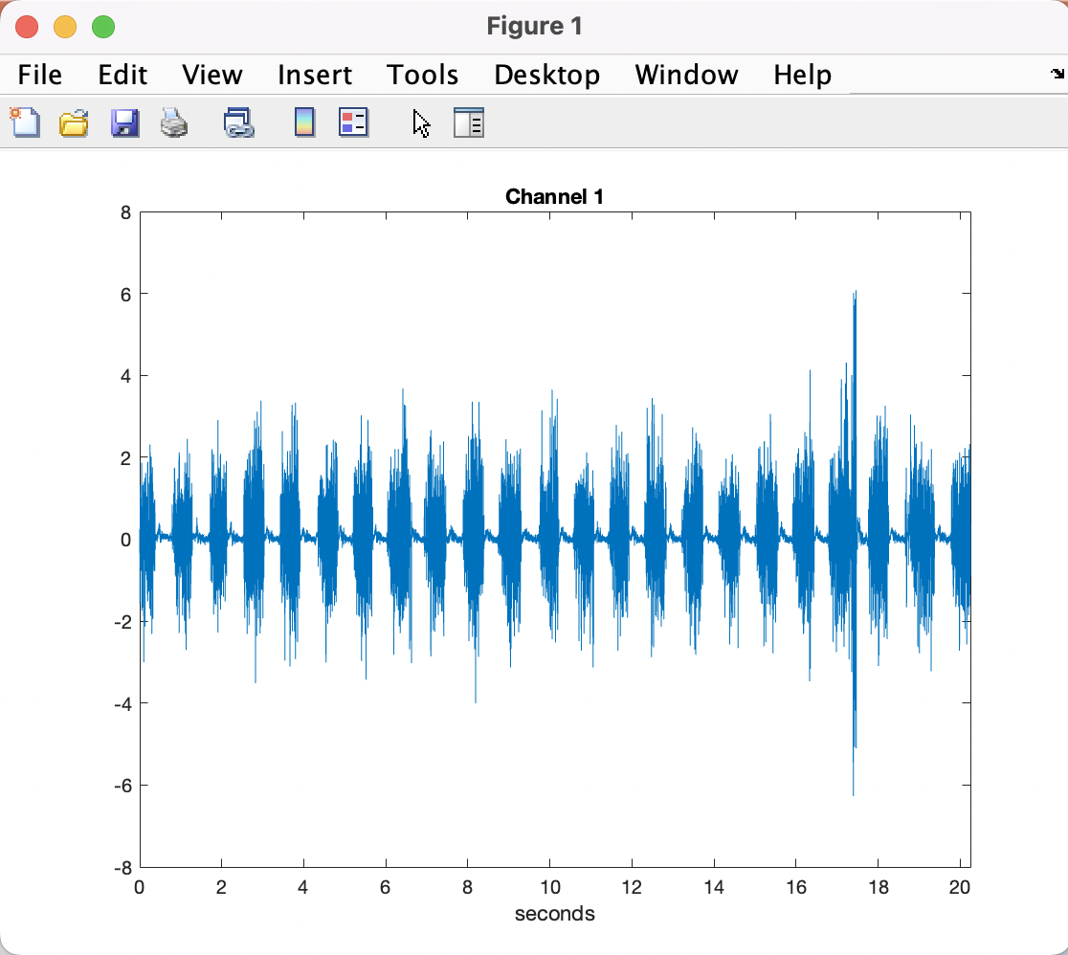
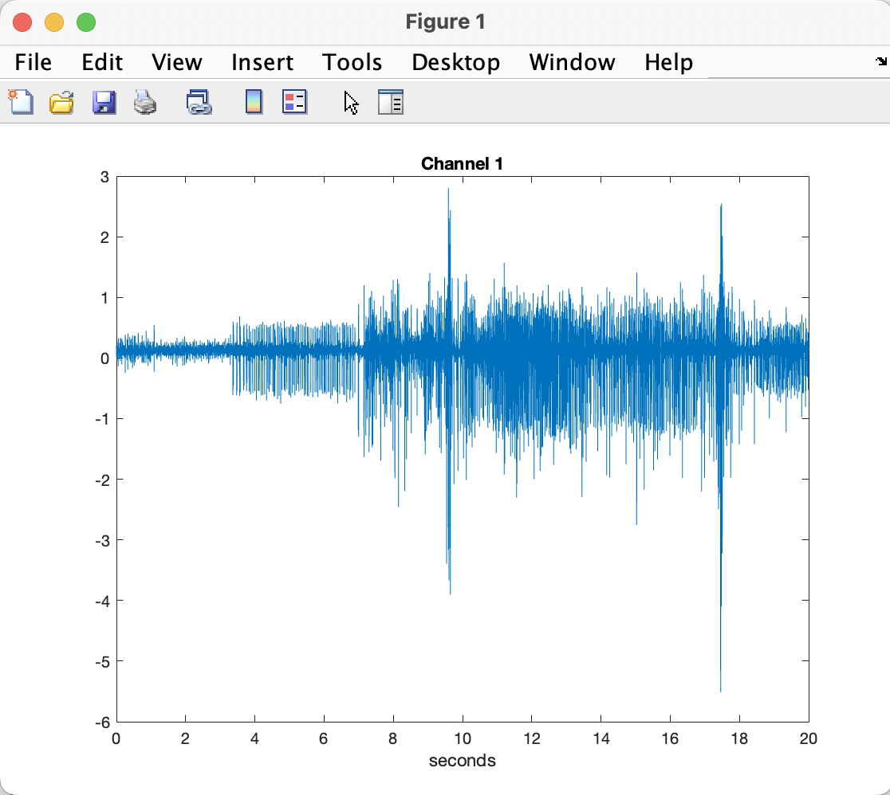
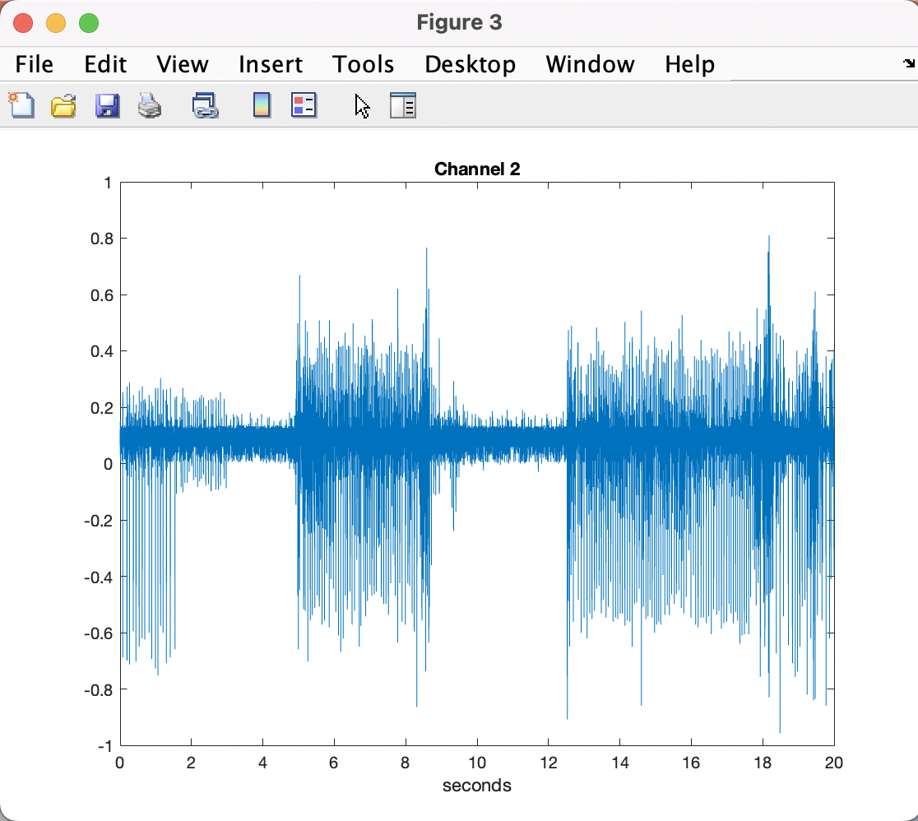
A) Input File
EMG_example_2_fs_2k
EMG_example_20s_2000Hz
EMG_example_1_90s_fs_2

Slide 4
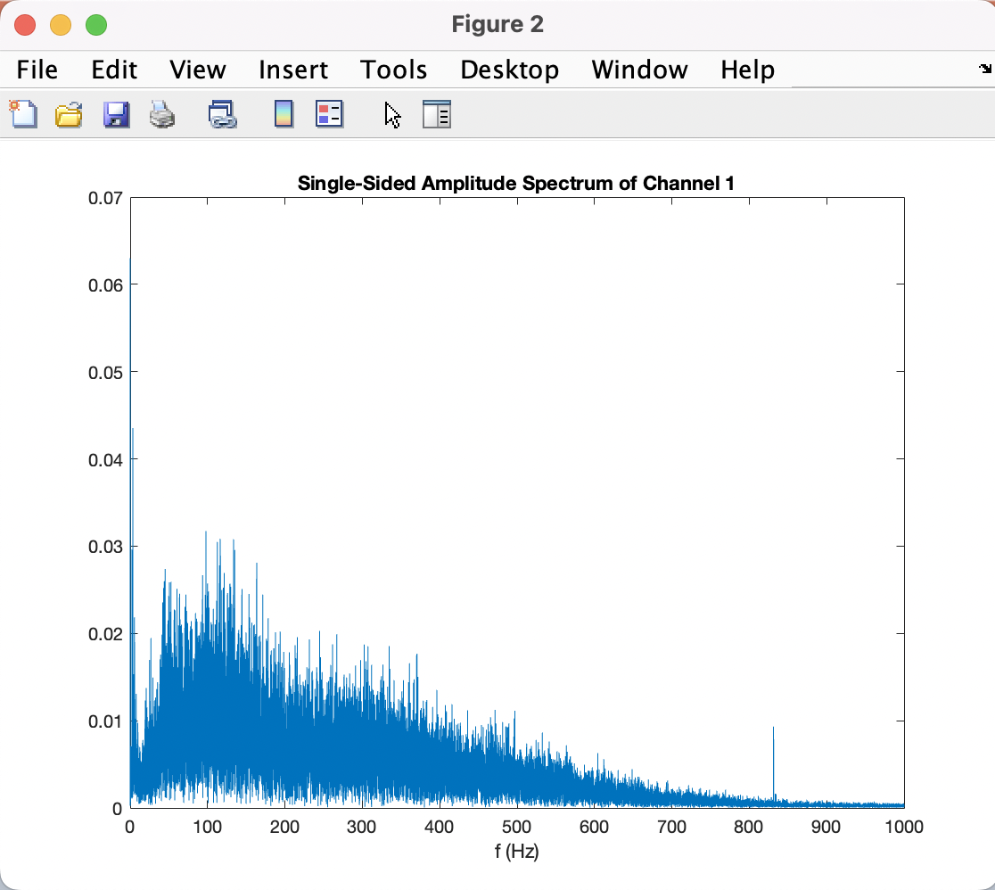
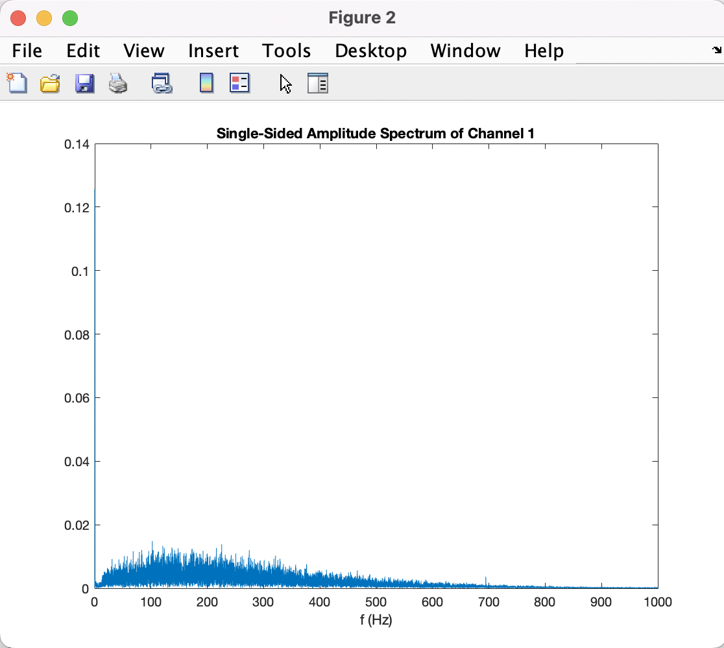
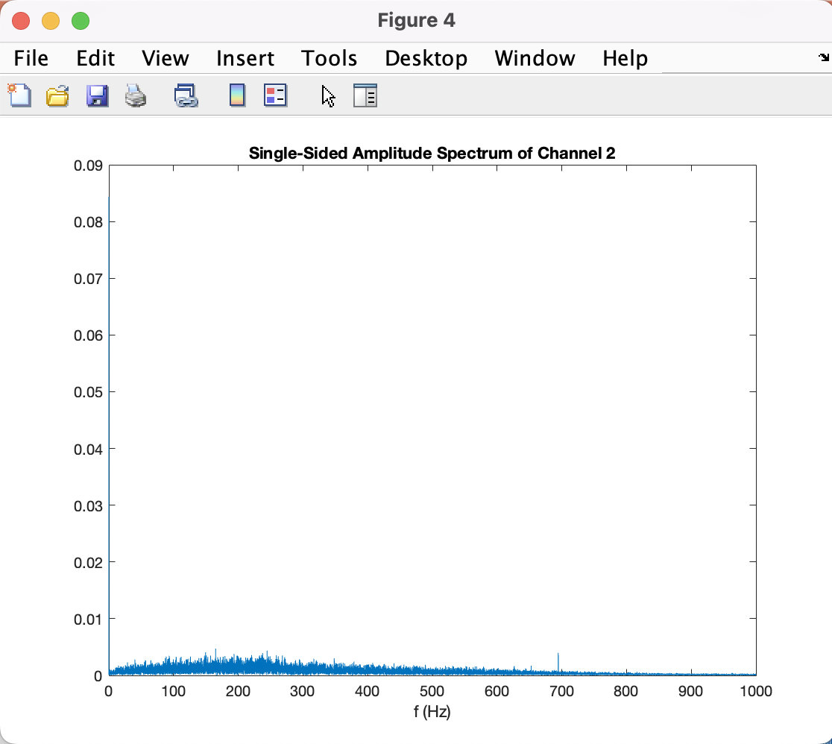
A) Input File cont.
EMG_example_2_fs_2k
EMG_example_20s_2000Hz
EMG_example_1_90s_fs_2

Slide 5
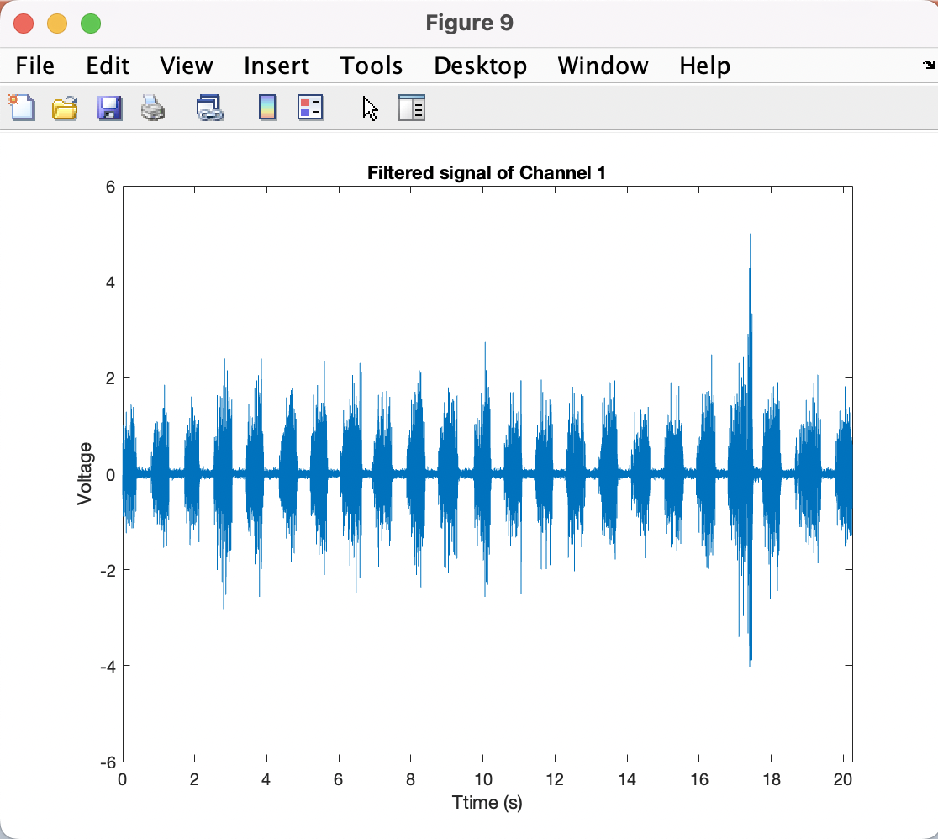
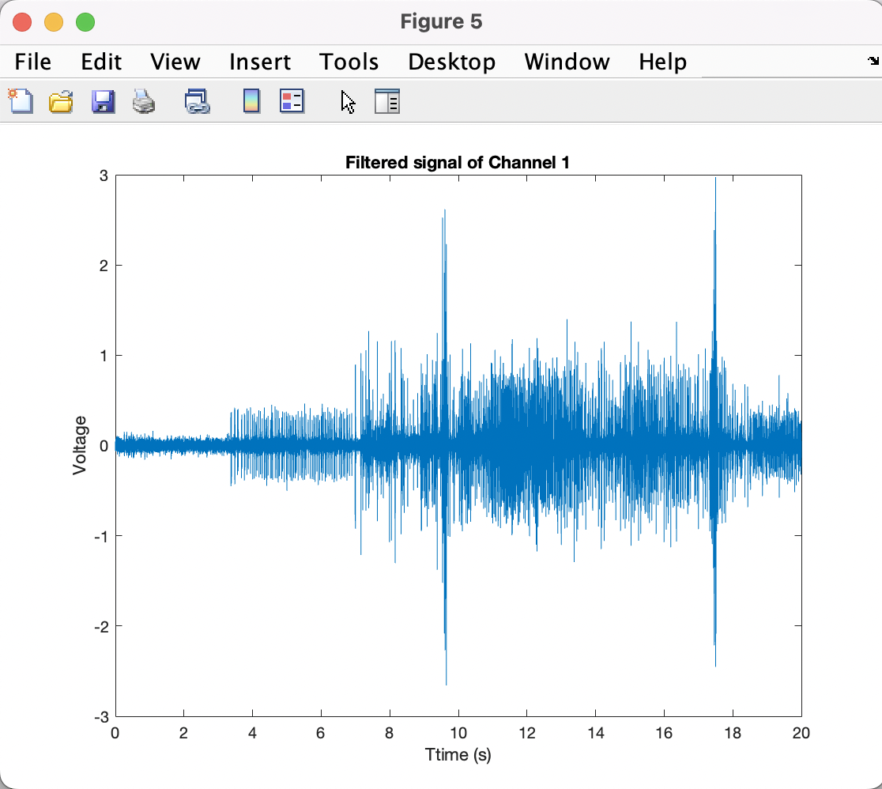
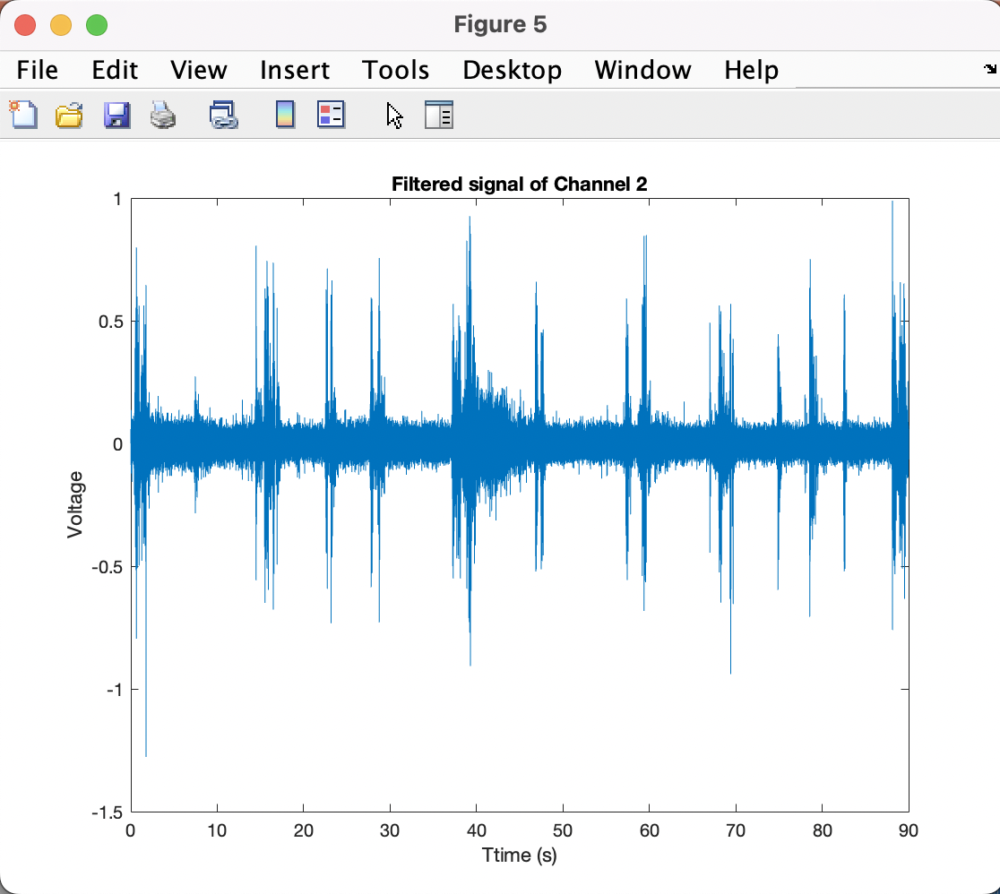
B) Filter Signal
EMG_example_2_fs_2k
EMG_example_20s_2000Hz
EMG_example_1_90s_fs_2

Slide 6
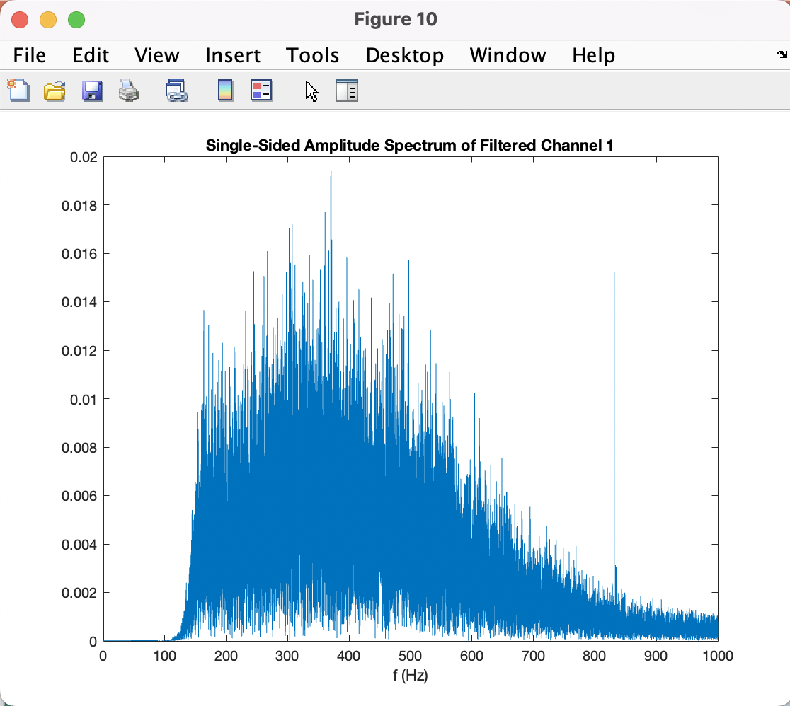
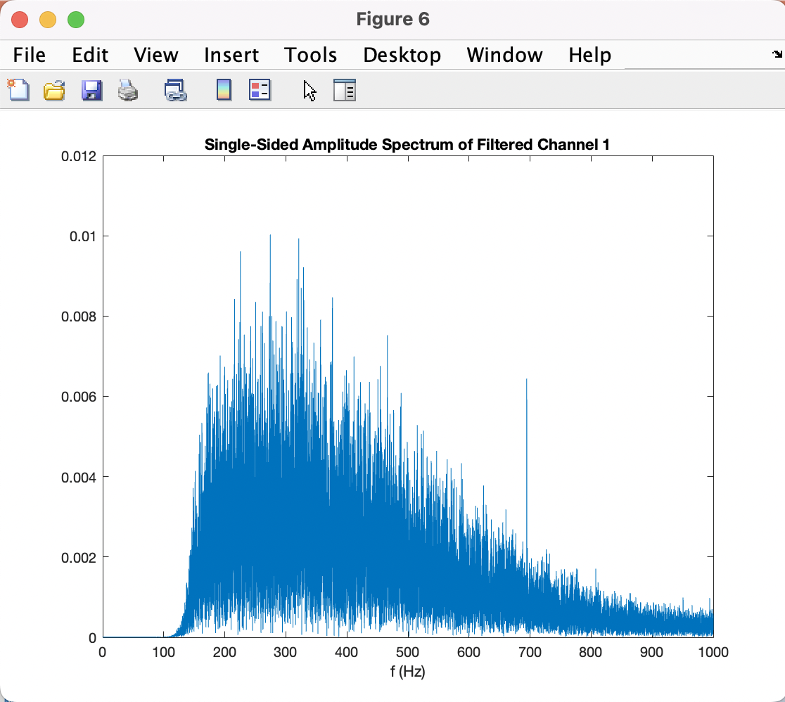
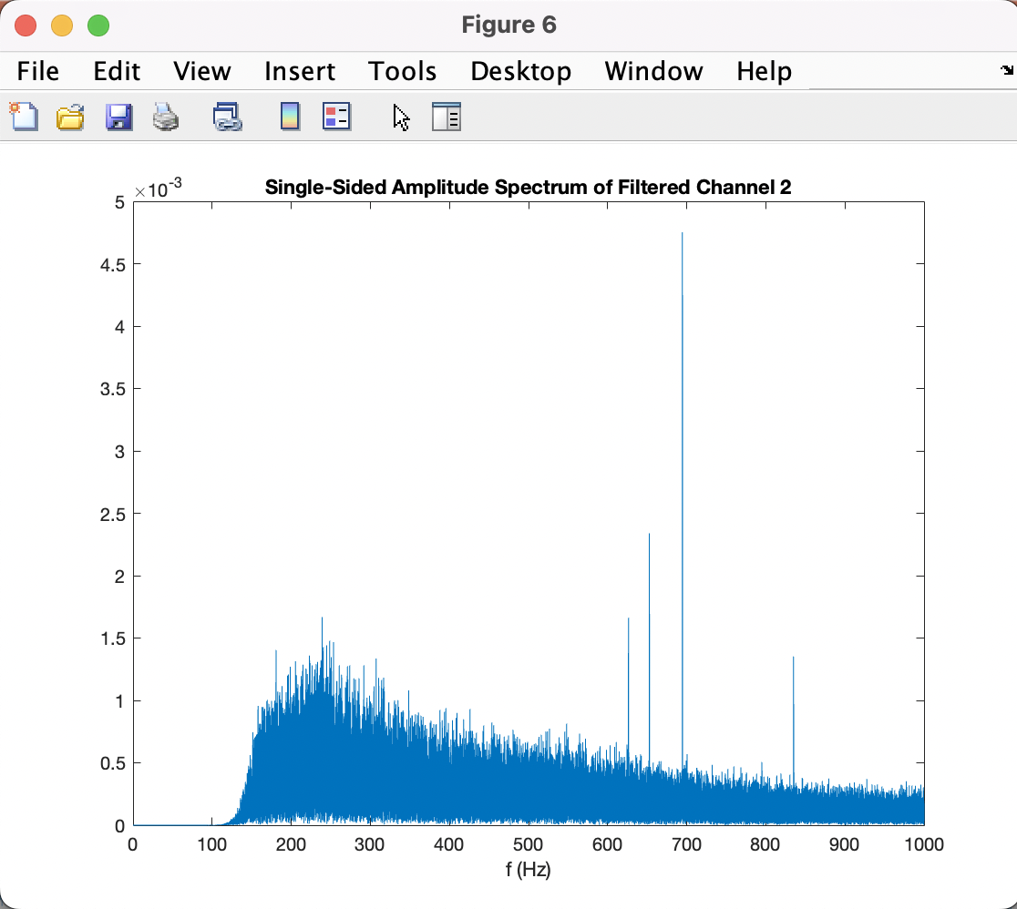
B) Filter Signal cont.
EMG_example_2_fs_2k
EMG_example_20s_2000Hz
EMG_example_1_90s_fs_2

Slide 7
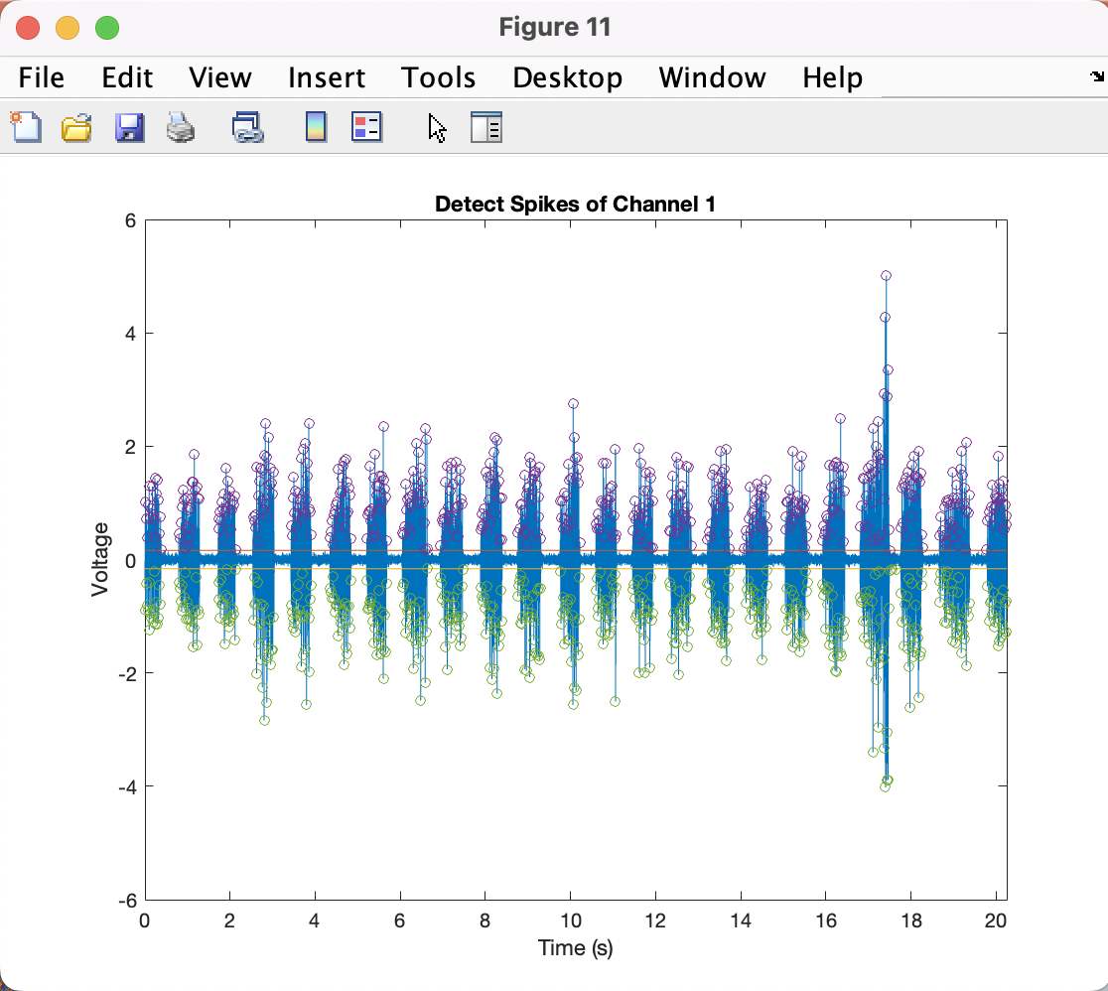

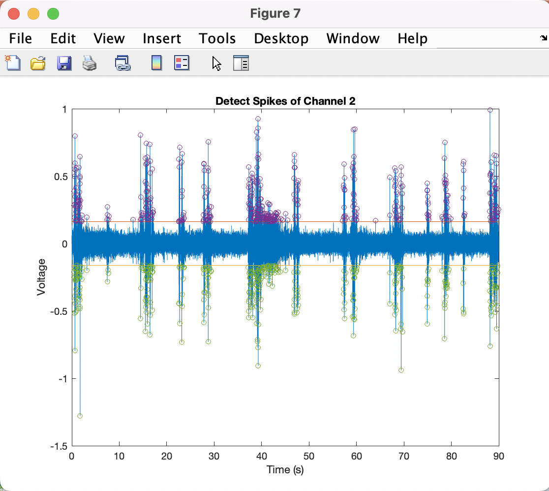
C) Detect Spikes
Threshold = 4*RMS of baseline noise
Threshold = 4*RMS of baseline noise
Threshold = 5*RMS of baseline noise
EMG_example_2_fs_2k
EMG_example_20s_2000Hz
EMG_example_1_90s_fs_2

Slide 8
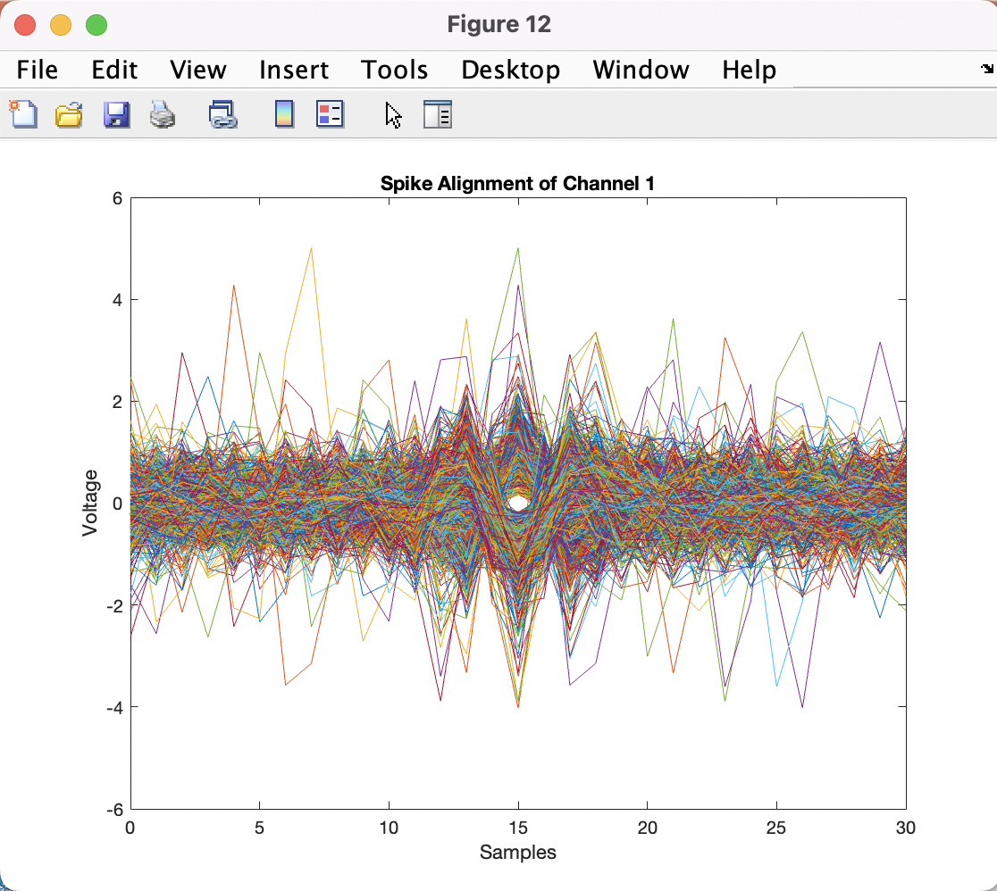
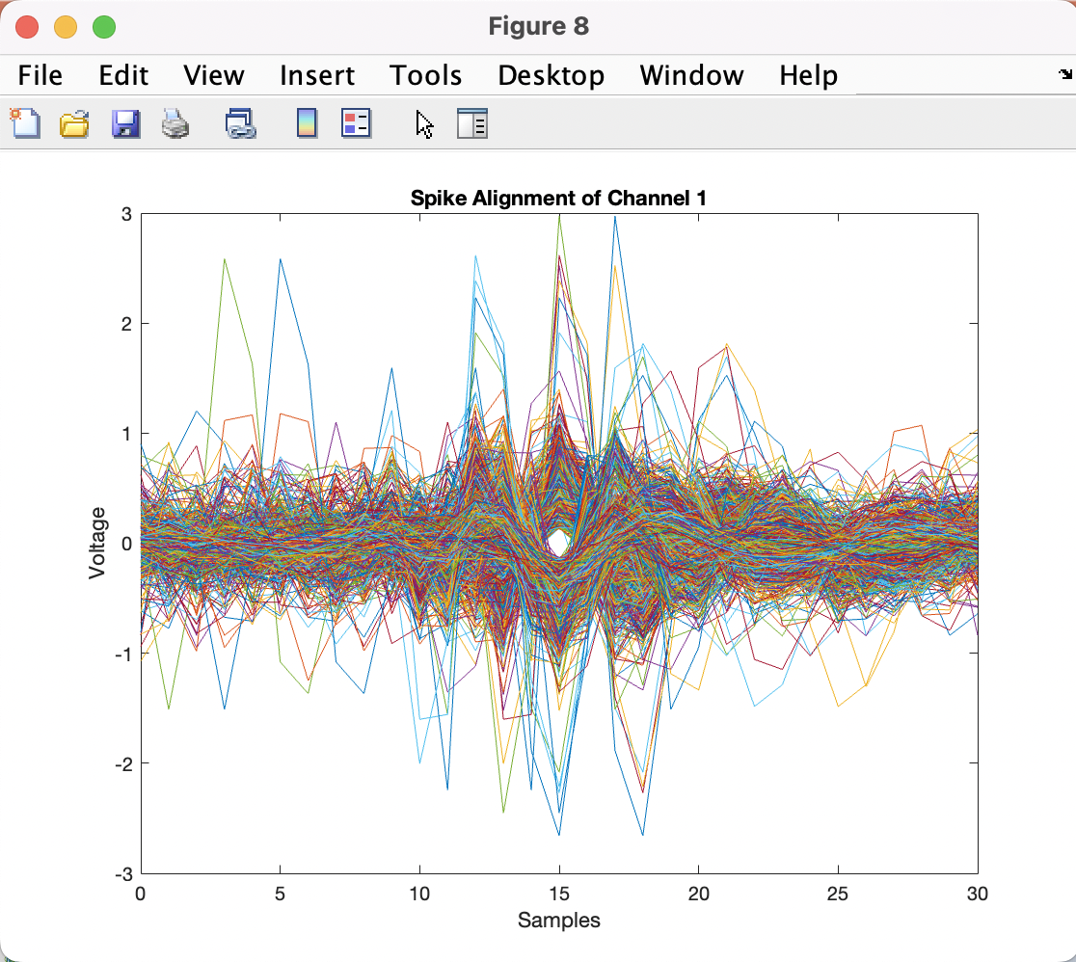
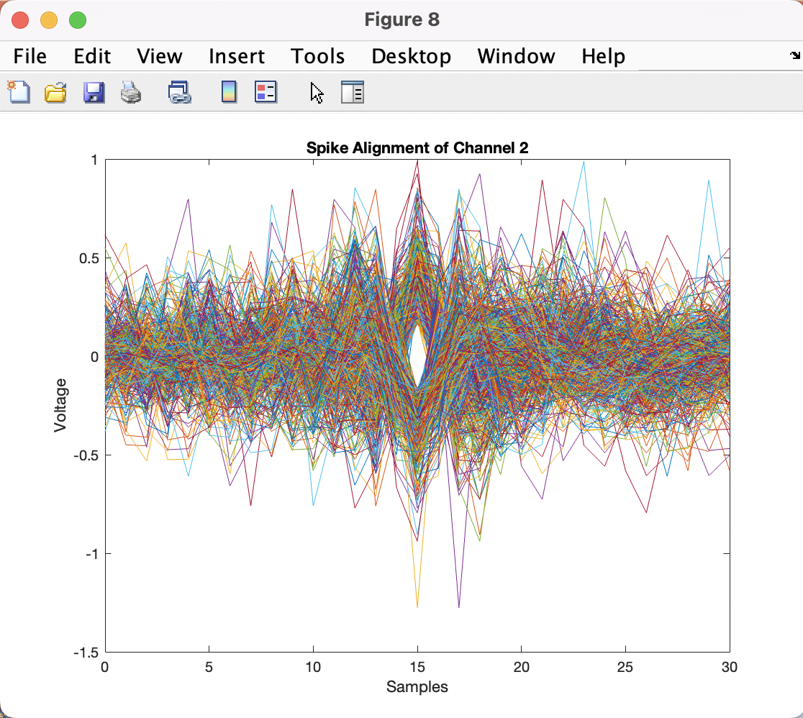
D) Align Spikes
EMG_example_2_fs_2k
EMG_example_20s_2000Hz
EMG_example_1_90s_fs_2

Slide 9
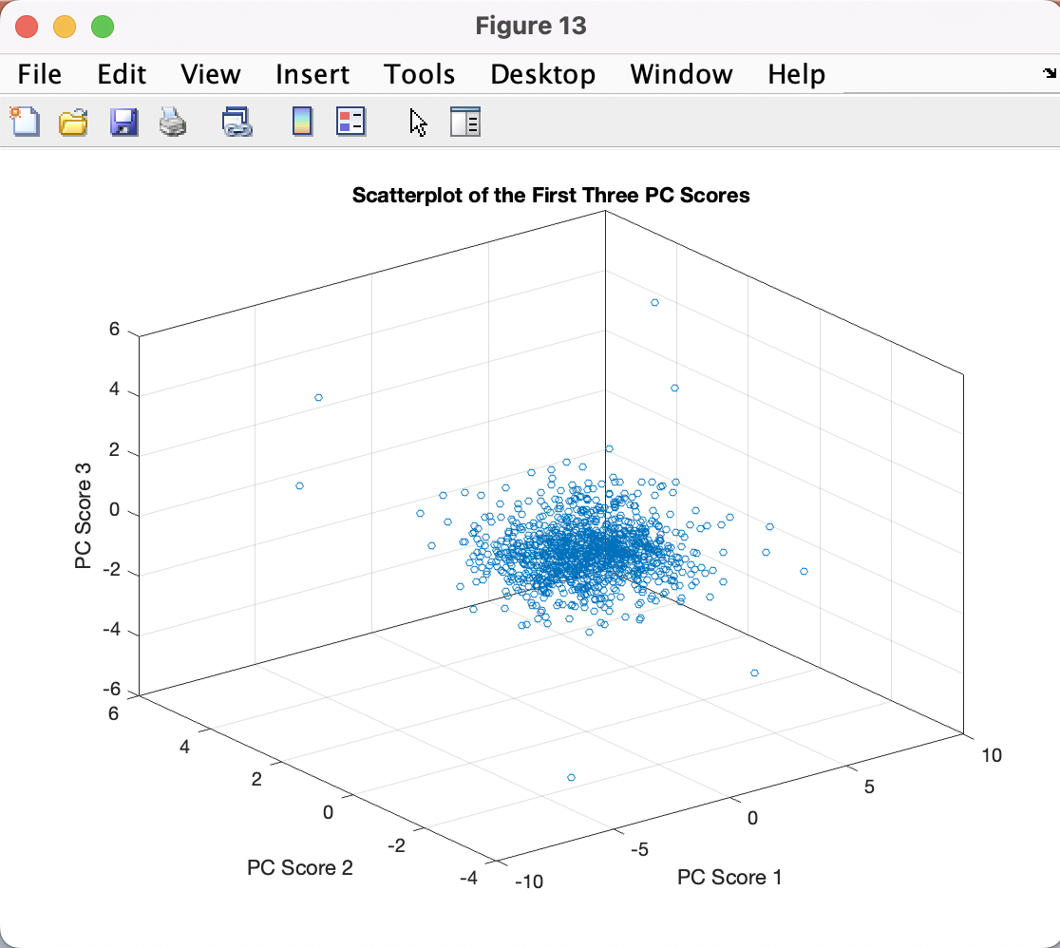
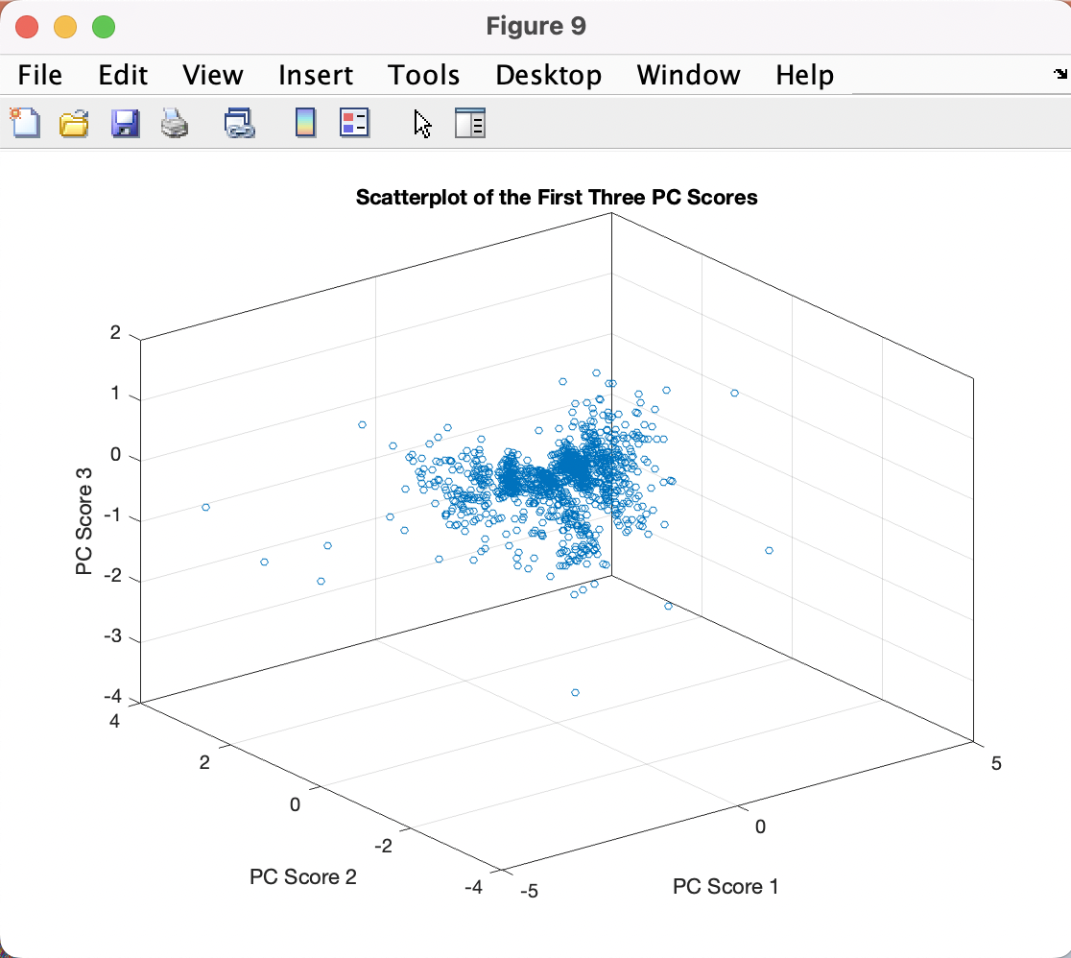
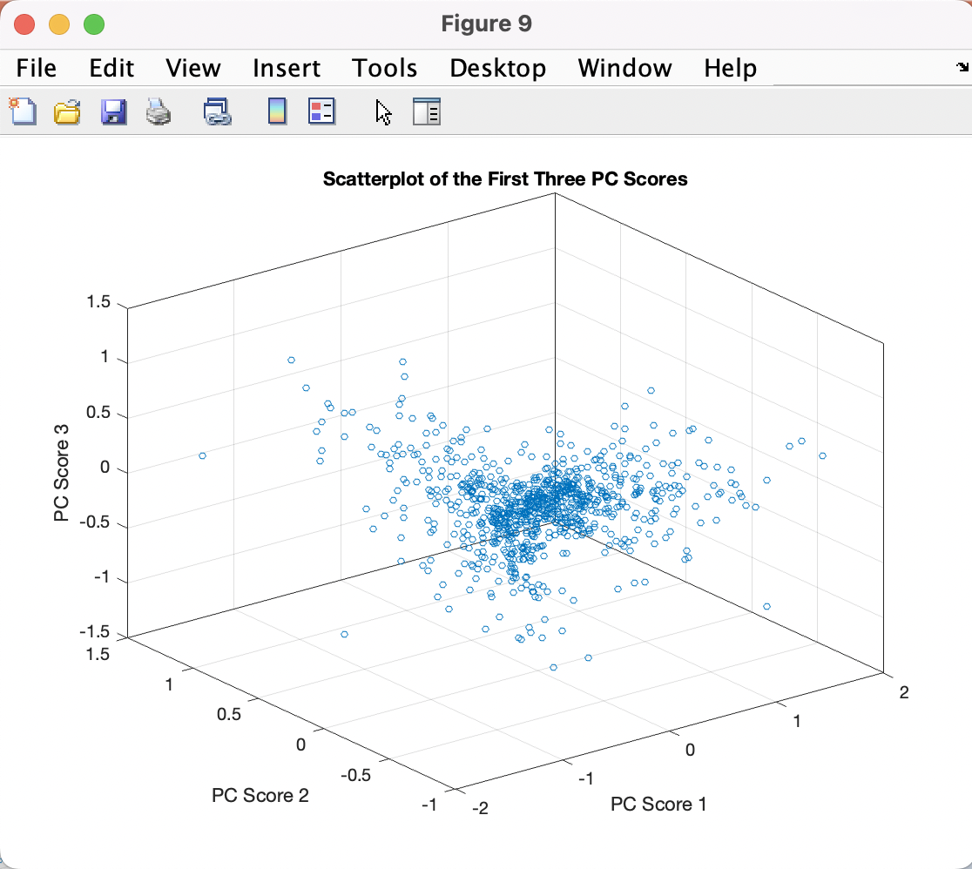
E) Extract Features
EMG_example_2_fs_2k
EMG_example_20s_2000Hz
EMG_example_1_90s_fs_2

Slide 10
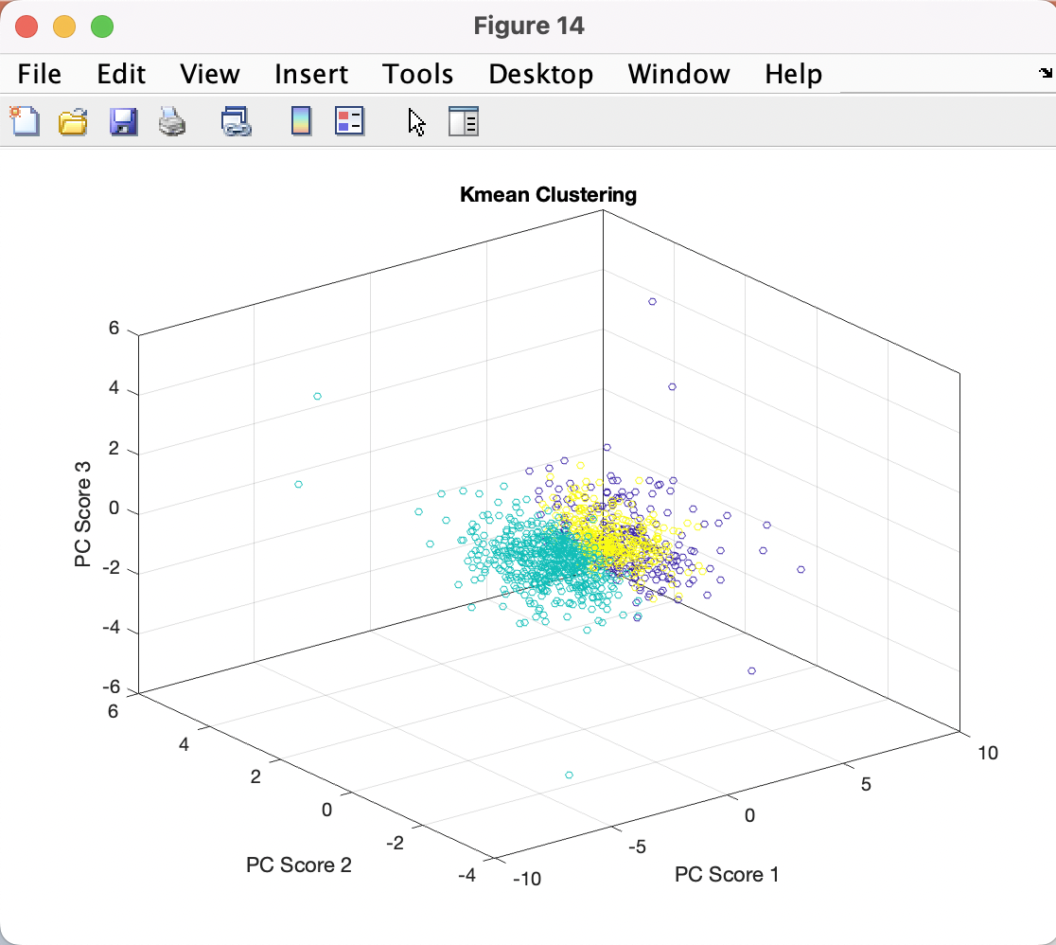
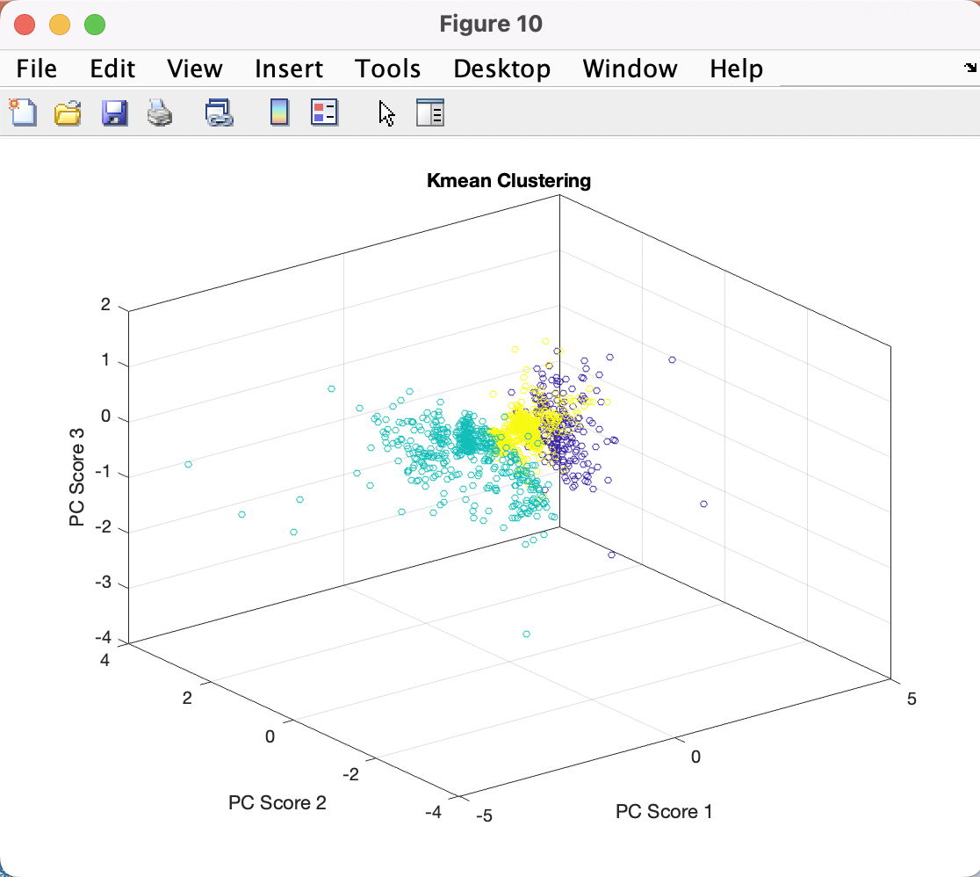
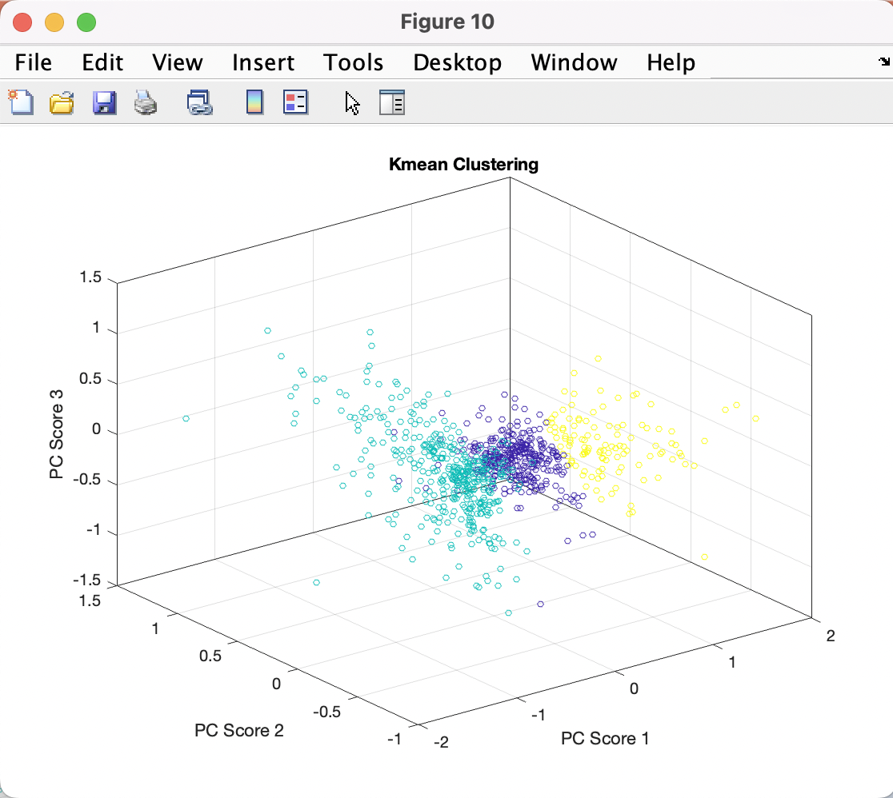
F) Cluster Spikes: 3D
EMG_example_2_fs_2k
EMG_example_20s_2000Hz
EMG_example_1_90s_fs_2
Cyan = Blue Yellow = Green Purple = Red

Slide 11
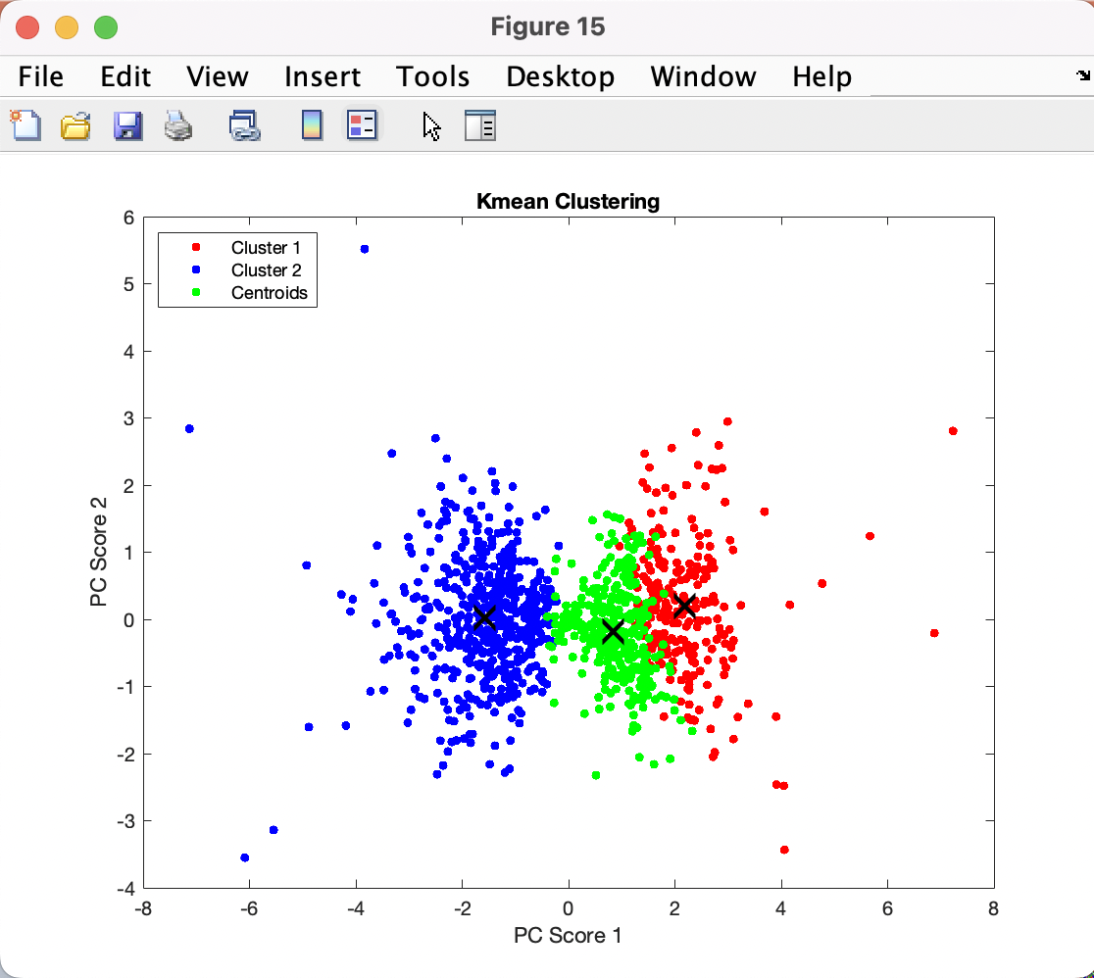
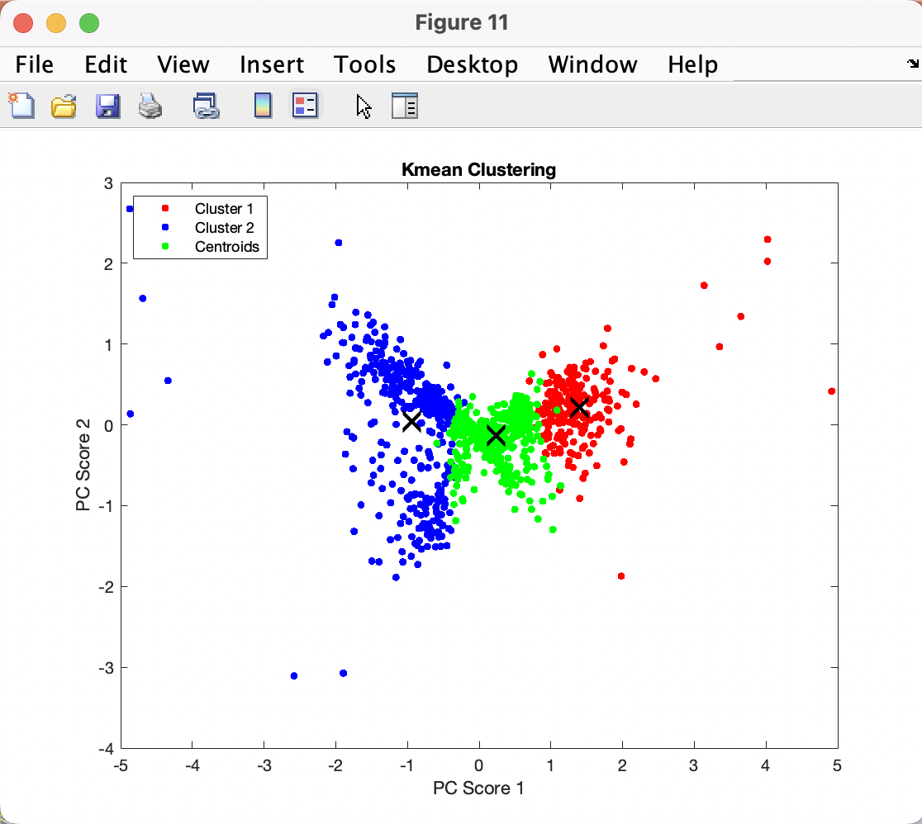
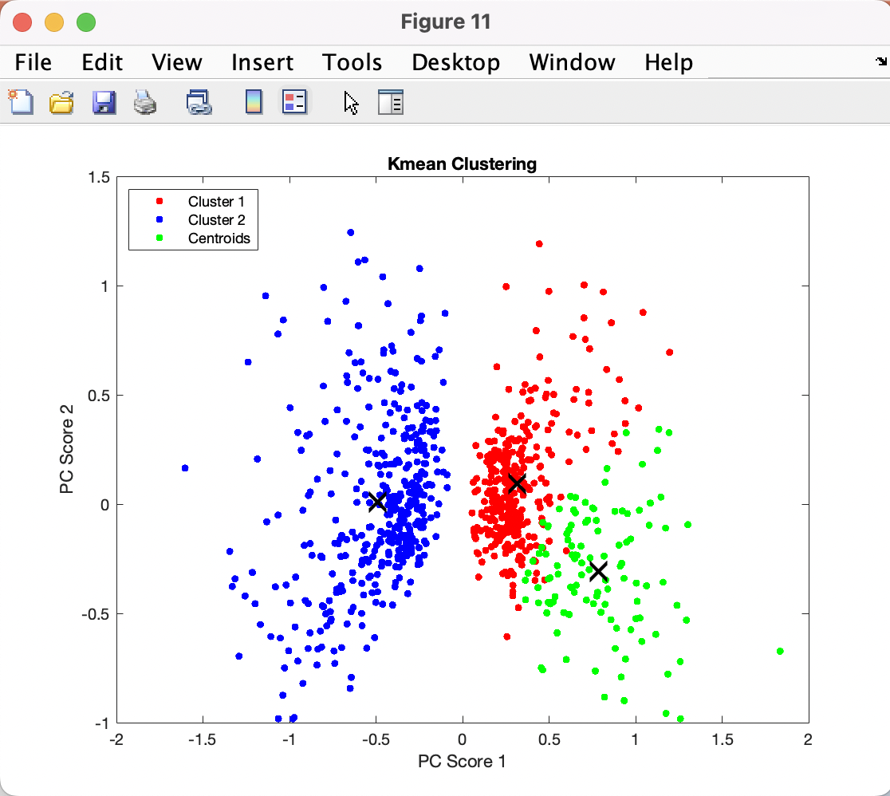
F) Cluster Spikes: 2D cont.
EMG_example_2_fs_2k
EMG_example_20s_2000Hz
EMG_example_1_90s_fs_2

Slide 12
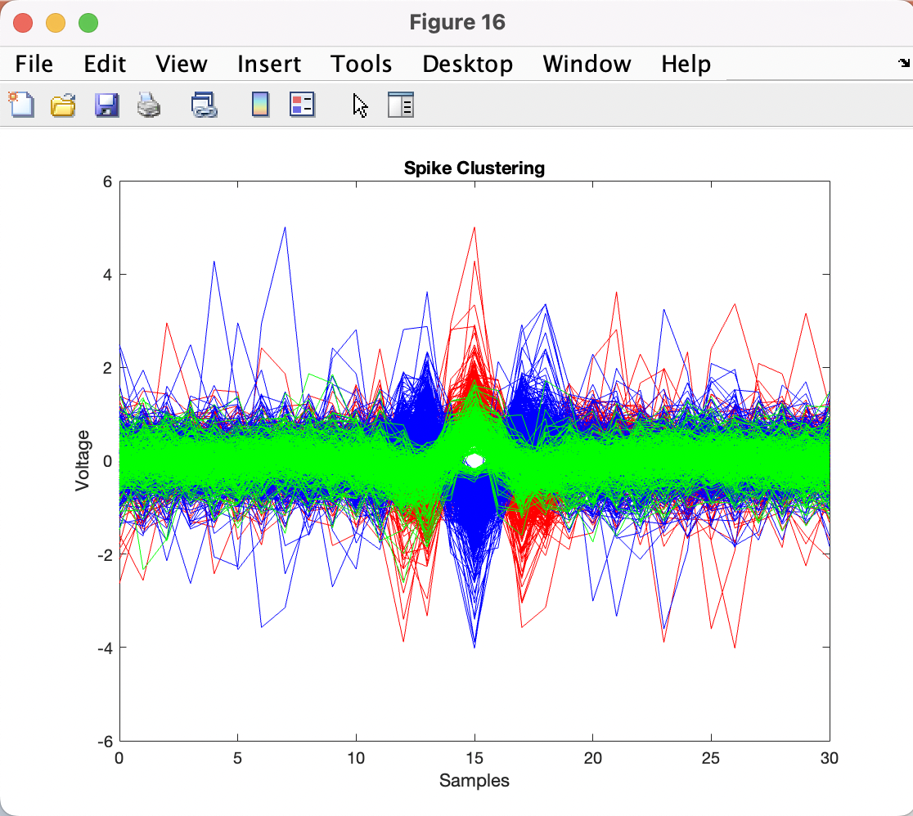
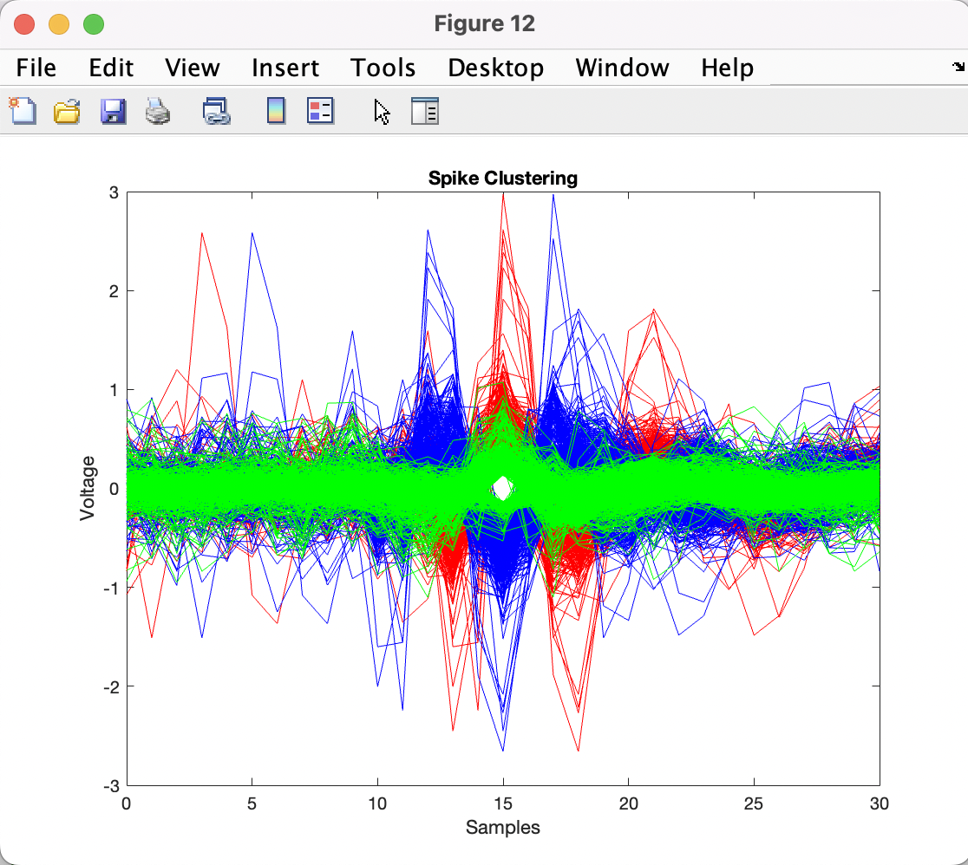
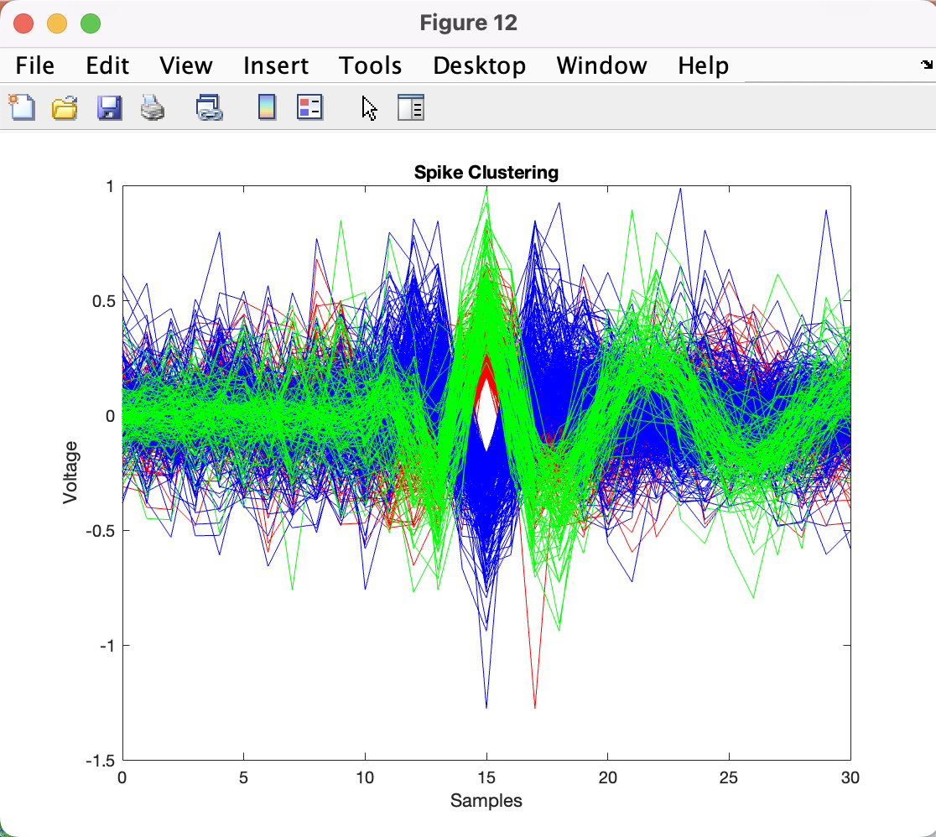
G) Classify Spikes
EMG_example_2_fs_2k
EMG_example_20s_2000Hz
EMG_example_1_90s_fs_2

Slide 13
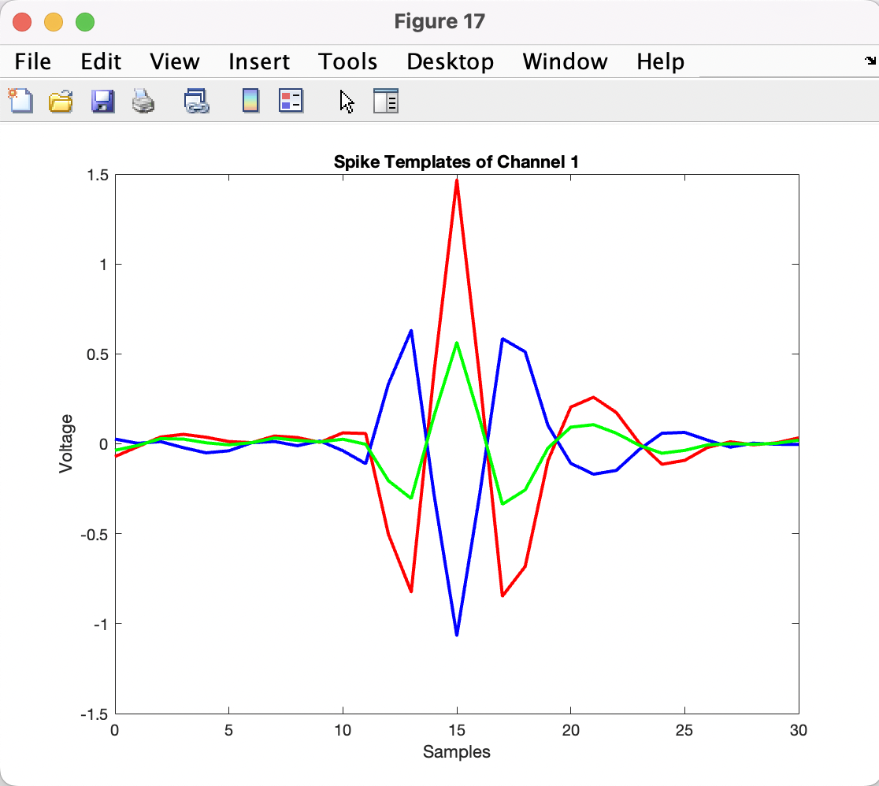
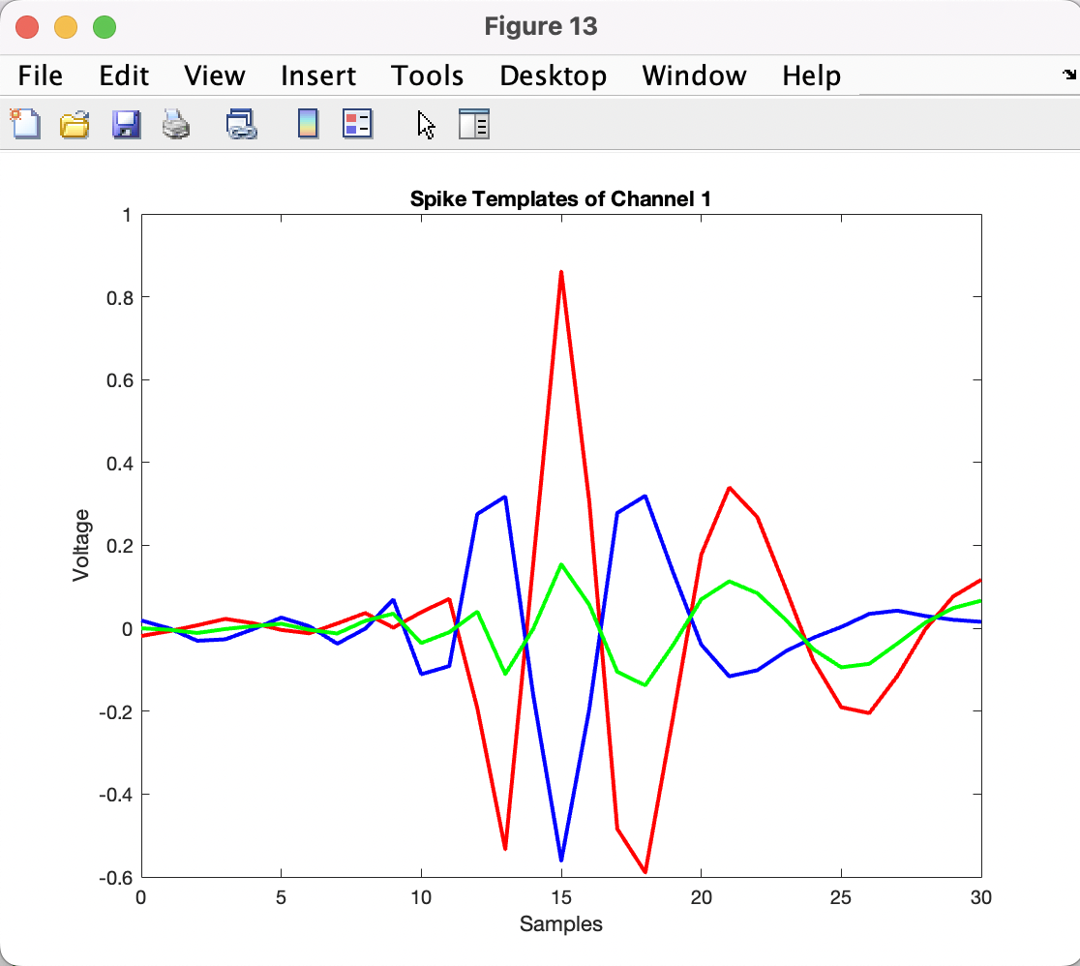
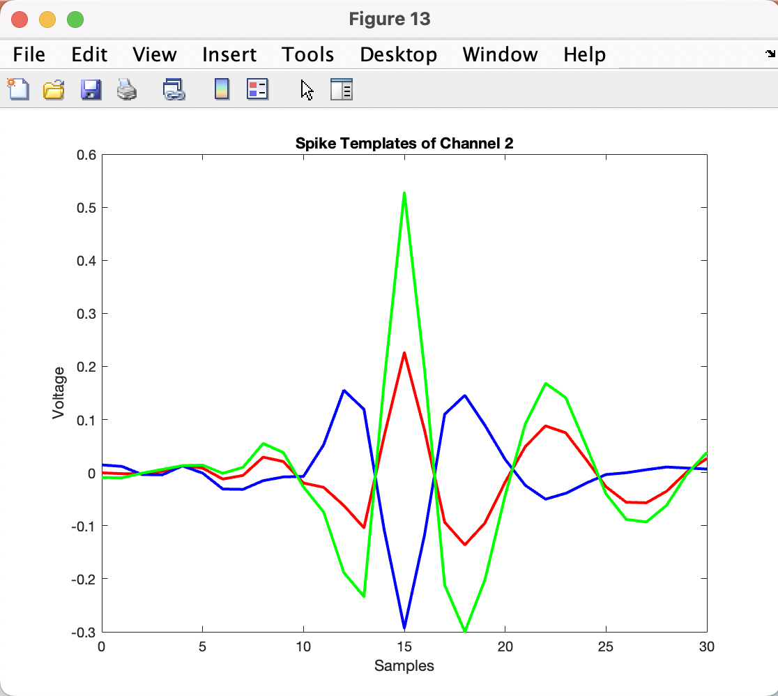
H) Analysis
EMG_example_2_fs_2k
EMG_example_20s_2000Hz
EMG_example_1_90s_fs_2
2 neurons
3 neurons
3 neurons
2 neurons
3 neurons
3 neurons
3 clusters, but spikes blue and red are almost the same (opposite amplitude)
3 clusters and all are different
3 clusters and all are different

Slide 14
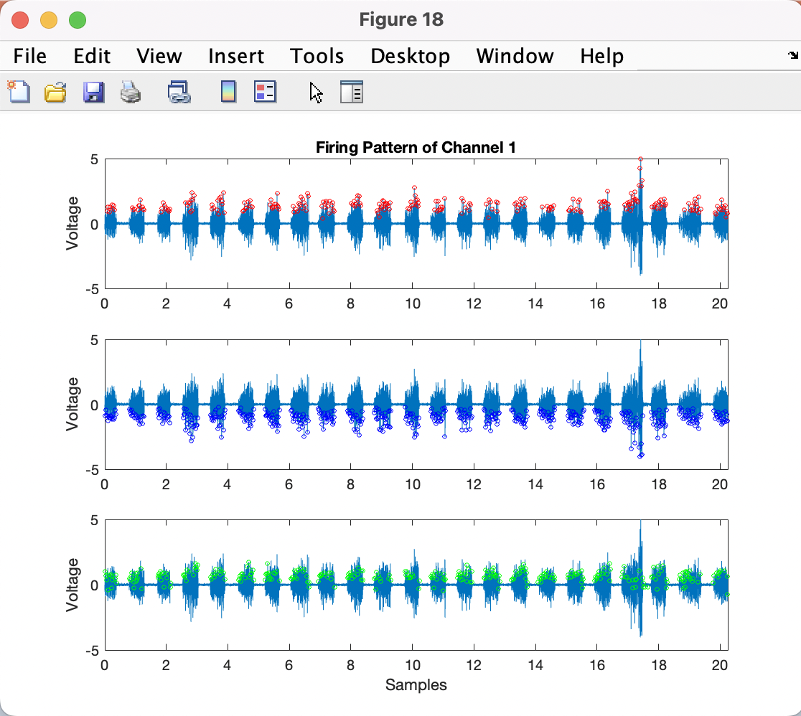
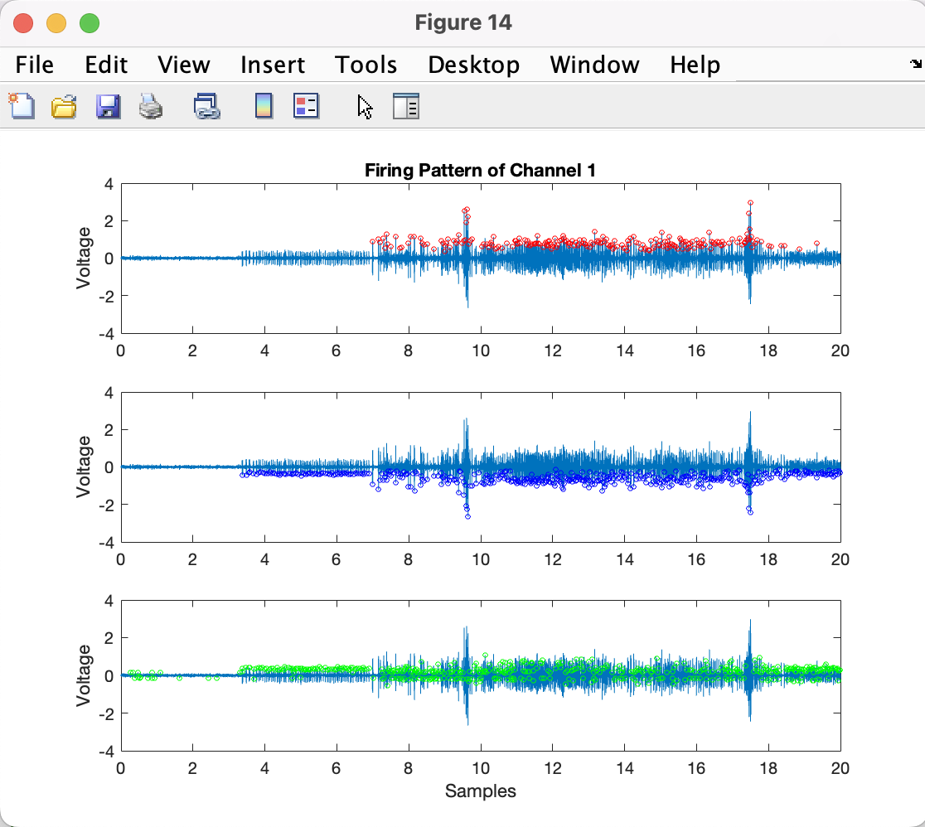
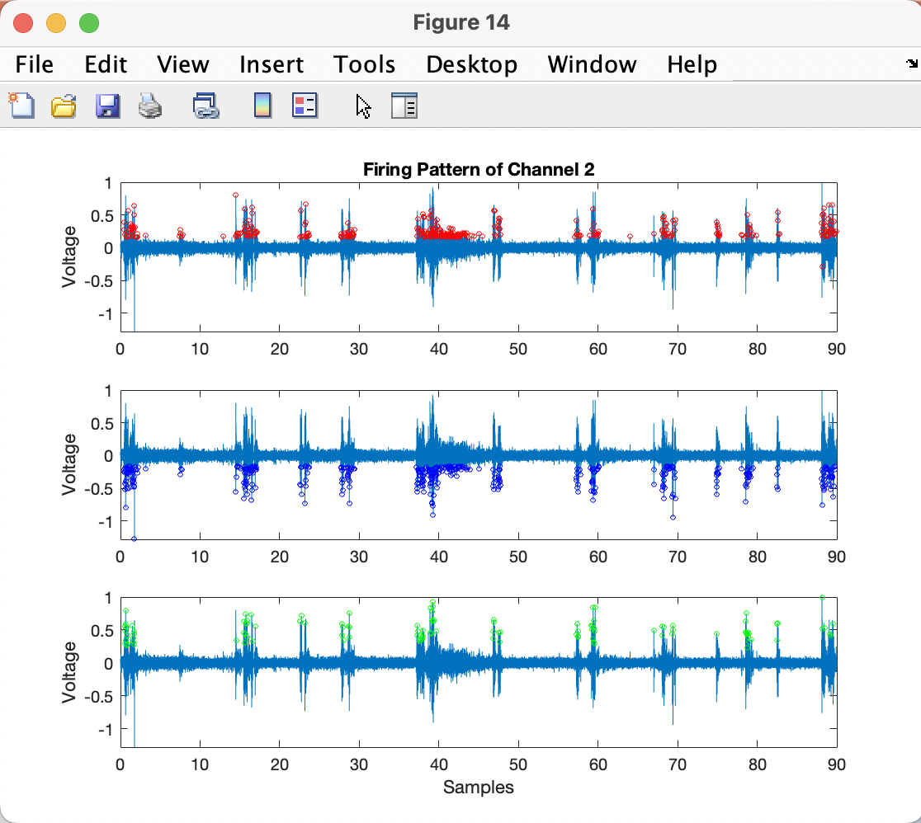
H) Analysis: Firing Pattern cont.
EMG_example_2_fs_2k
EMG_example_20s_2000Hz
EMG_example_1_90s_fs_2
1110 Spikes:
257 in red cluster
529 in blue cluster
324 in green cluster
1154 Spikes:
223 in red cluster
452 in blue cluster
479 in green cluster
853 Spikes:
340 in red cluster
400 in blue cluster
113 in green cluster

Slide 15
Discussion
Input File: Plotting the EMG data as well as the spectrum to find the cutoff frequency for the filter.
Filter Signal: Differentiating the signal to improve SNR and applying a high-pass filter at 150Hz helps in noise removal. The cutoff frequency appears to be optimal in the range [100,250]Hz. Beyond this range, the filter is useless for clustering and distorts the sound excessively for higher cutoff frequencies. I was not sure how to estimate SNR as I don’t know the source signal in the first place.
Detect Spikes: Finding all the peaks above the threshold. I noticed that using a slightly higher threshold than the 3*RMS gives a better result for clustering. I noticed best results when using a 4*RMS or 5*RMS threshold. Increasing the threshold will take less spikes and give less clusters. Decreasing it will take too many spikes and also give less clusters.
Align Spikes: Plotting all the spikes in the same time window. I chose a window of 15ms to align the spikes and to represent them with enough accuracy. It corresponds to 30 samples as the sampling frequency is 2kHz.

Slide 16
Discussion cont.
Extract Features: Using the PCA method, I am able to extract the principal components and plot a scatterplot of the 3 most significant PC scores. Important note: Matlab pca() function was giving me a slightly different result each time I ran it. There might be a random component inside the method. I used "rng(1)” to set the MATLAB’s random seed to a specific number.
Cluster Spikes: Using the kmeans method, I group the features from the last step into clusters.
Classify Spikes: Based on this clustering, I show the plot from ‘Align Spikes’, where each spikes is attributed to a specific cluster/ color.
Analysis: Extracting the spike templates allows us to see the average action potentials. From that, we can find the number of neurons corresponding to the number of different templates. I was also able extract the number of spikes for each cluster (Firring Pattern) to see the most ‘active’ neuron.

Slide 17
Conclusion
The lack of ground truth data makes quantitatively evaluating the efficacy of EMG decomposition difficult.
Qualitatively, this method appears to be fairly successful at distinguishing spikes with significantly different amplitudes and biphasic vs triphasic spikes.
It cannot distinguish between spike pairs that occur very close together, since one of those spikes will be ignored during detection.
It does not work well if there is a very large difference between the spike amplitude of different motor units. This is because the threshold is constant and so can be biased higher and thus miss lower amplitude spikes.
Additionally, data with a significant number of artifacts can strongly impact results since artifact removal was not directly addressed in the pipeline.
Overall, this method presents a straightforward implementation of EMG decomposition that is successful at detecting motor units with significantly different action potentials, provides informative visualizations, and creates a framework that can be built upon for improvement.

Slide 18
Future Improvements
Using a Nonlinear Energy Operator (NEO) based spike detection for a better threshold
An algorithm that adjusts the threshold depending on signal properties, like the EC-PC spike detection discussed by Professor Liu, could also be used to mitigate issues with the biased constant threshold.
Use a different filter than Butterworth maybe a bandpass filter.
Using a filter that adapts to varying signal-to-noise ratios over the course of a recording could also improve results.
Make code PCA to optimize it (instead of using the built-in Matlab function).
Use a different method for clustering than kmeans, such as: clusterdata or linkag.
For the analysis, finding the firing rates using bins, and then finding the Inter Spike Interval Distribution (ISIs). The ISI distribution can help give information about spike classification accuracy since motor units generally fire around the same frequency so if the ISIs are very spread it out (high variance), it would suggest that the spikes may not all be from the same unit.

